Slide 1
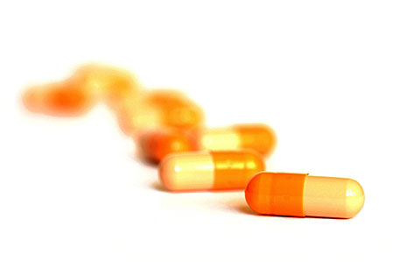
Take Two Software Updates and See Me in the Morning:
The Case for Software Security Evaluations of Medical Devices
Steve Hanna¹, Rolf Rolles⁴, Andres Molina-Markham², Pongsin Poosankam^{1,3}, Kevin Fu², Dawn Song¹
University of California – Berkeley¹, University of Massachusetts Amherst²,
Carnegie Mellon University³, Unaffiliated⁴

Slide 2
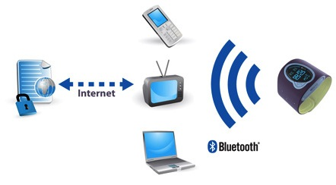
Changing Medical Device Landscape
Increased software complexity
Software plays an increasing role in device failure
  2005-2009 (18%) due to software failure, compared to (6%) in 1980s
Increased attack opportunities
Medical device hardware and software is usually a monoculture within device model
Health Data
Connected
Devices
Medical
Device
Automated External Defibrillators
28,000 adverse event reports in 14 Models recalled 2005-2010.

Slide 3
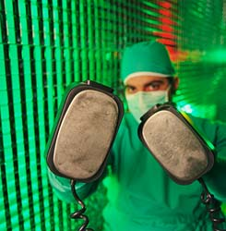
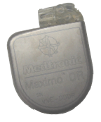
To be clear…
AEDs
ICDs
X

Slide 4
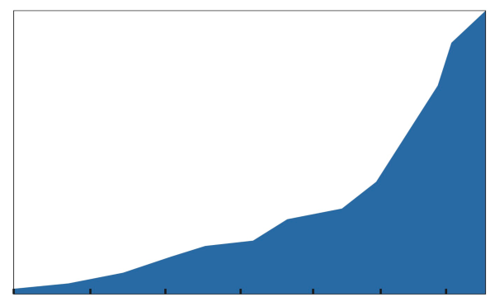
1,582,691
The Population of AEDs Has
Increased Significantly Over the Past 5 Years
AEDs Worldwide
1996
1998
2000
2002
2004
2006
2008
Automated External Defibrillator Milestones
PAD Trial Published
First AED with biphasic waveform
New York requires AEDs in public places
First save on US airline
74% survival rate in casinos
Wisconsin requires daycare providers to be AED proficient
75% survival rate in O’Hare Airport
Global Automated External Defibrillators (AED) Market: Demand to Drive Growth; June 2009 U.S., European and Japanese External Defibrillation (PAD) Market Report. Frost & Sullivan. 2000. Valenzuela TD, et al. N Engl J Med. 2000;343:1206-1209. Caffrey S, et al. N Engl J Med. 2002;347:1242-1247.

Slide 5
Our Objectives
Explore state of AED software security
Examine for standard software security flaws
  Data handling, coding practices, developer assumptions
Give insight into state of medical device software and potential for future abuse

Slide 6
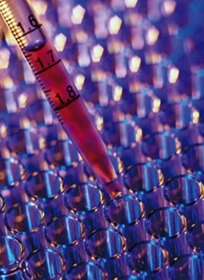
Desirable Medical Device Properties
The device should:
  Ensure that software running on a system is the image that was verified
  Detect compromise
  Verify and authenticate device telemetry
  Be robust: defenses and updates weighed with risks to patient

Slide 7
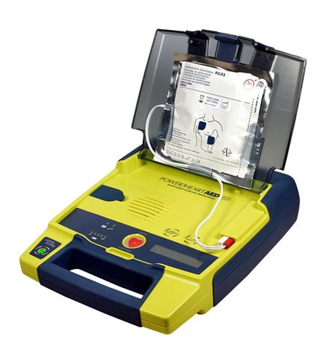
Case Study
Analyzed Cardiac Science G3 Plus model 9390A
Performed static reverse engineering using IDA Pro
  Analyzed: MDLink, AEDUpdate and device firmware
Analysis using BitBlaze architecture
  BitFuzz, the dynamic symbolic path exploration tool
Remarks
  Problems likely not isolated to the G3 Plus
  Potential for abuse as devices become more connected

Slide 8
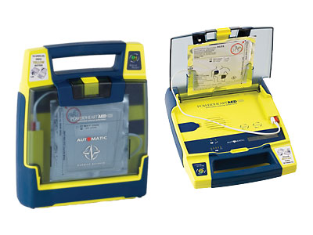
Vulnerabilities Discovered
AED Firmware - Replacement
AEDUpdate - Buffer overflow
AEDUpdate - Plain text user credentials
MDLink - Weak password scheme
Vulnerabilities were verified on Windows XP SP2.

Slide 9
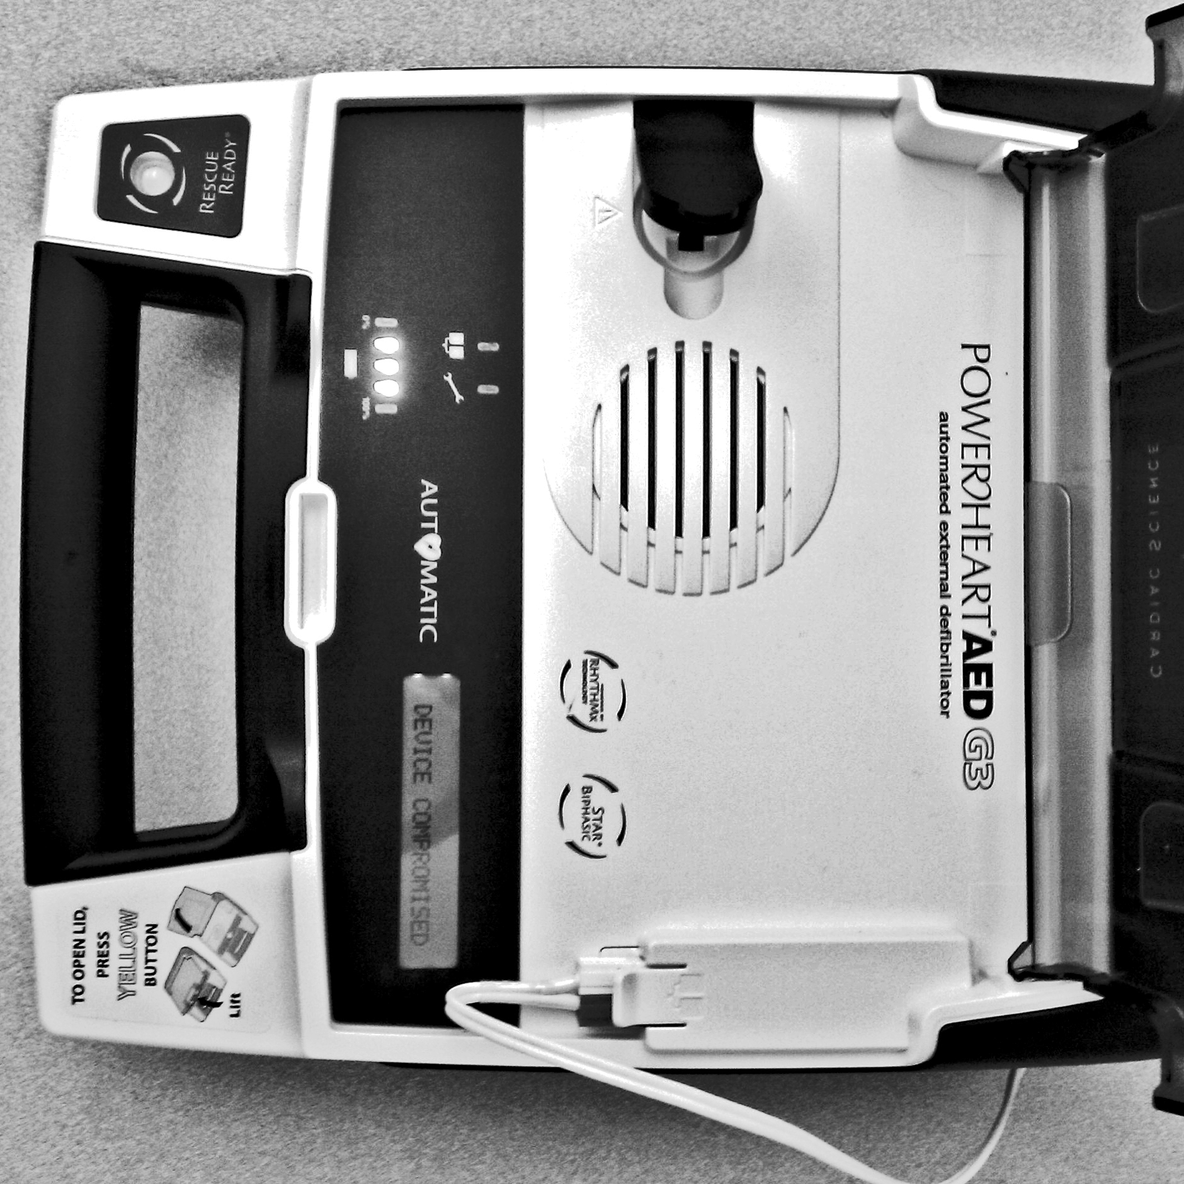
Firmware Replacement
Firmware update uses custom CRC to verify firmware
Modified firmware, with proper CRC, is accepted by AED and update software
Impact: Arbitrary firmware
DEVICE COMPROMISED

Slide 10
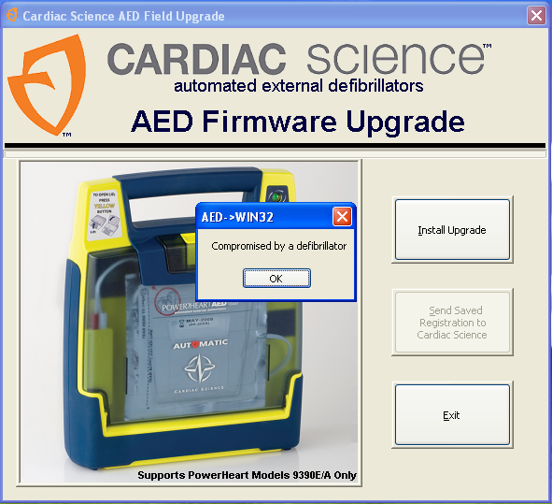
AEDUpdate Buffer Overflow
During update device handshake, device version number exchanged
AEDUpdate improperly assumes valid input
Enables arbitrary code execution
  Data sent from AED can be executed as code on the host PC

Slide 12
Improving Medical Device Security for Developers
Lessons and open problems from the CS G3 Plus
  Cryptographically secure device updates
    No security through obscurity, ensures firmware authenticity
  Device telemetry verified for integrity and authenticity
    Defensively assume that data is not trusted
  Passwords cryptographically secure and easily managed
    Private data and life critical functionality should be protected by well-established cryptographic algorithms
  Defenses and updates weighed with risks to patient
    Medical devices should fail open

Slide 13
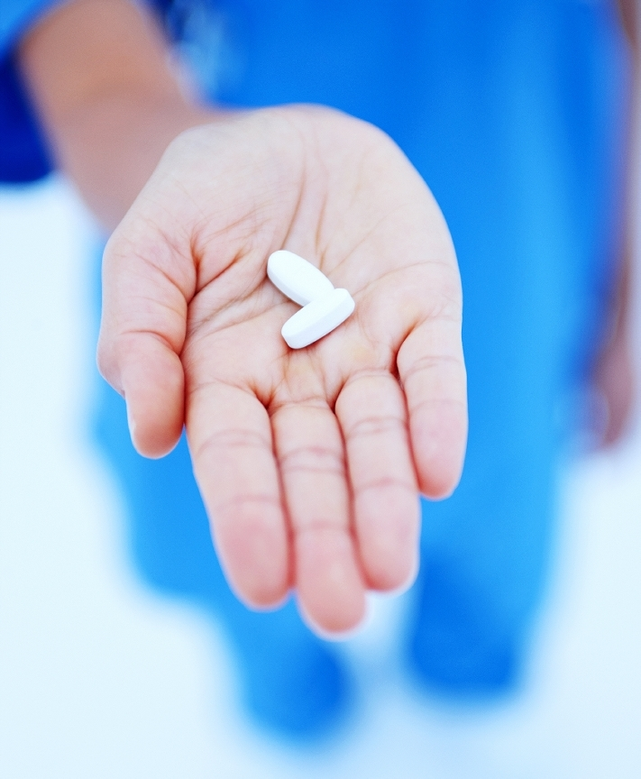
Recommendations
Ensure the update machine is secure
  Physical isolation, virtual machine for fresh install
Follow FDA guidelines and advisories
Remain vigilant
  Monitoring physical access, routinely updating afflicted devices, and monitoring advisories released about the device

Slide 14
Final Recommendation
We recommend continued use of AEDs because of their potential to perform lifesaving functions.
The attack potential is currently unmeasured and currently, these devices overwhelmingly save more lives than they imperil.

Slide 15
Thank You
Questions?
  Contact:
    Steve Hanna (sch@eecs.berkeley.edu)
    Dawn Song (dawnsong@cs.berkeley.edu)
    Kevin Fu (kevinfu@cs.umass.edu)
  secure-medicine.org

